Slide 1
Economic impacts
Science and scenarios
Abatement costs
Instruments for emission reduction
Impacts of climate change; valuation
Economic impacts; marginals; distribution
Impacts and development
Adaptation policy
Optimal climate policy
Discounting, equity, uncertainty

Slide 2
Economic impacts
Why estimate the total economic impact of climate change?
Methods
Results and caveats
Weather v climate
Social cost of carbon
Distribution of impacts
Schelling conjecture
Impact on economic growth
Climate and development

Slide 3
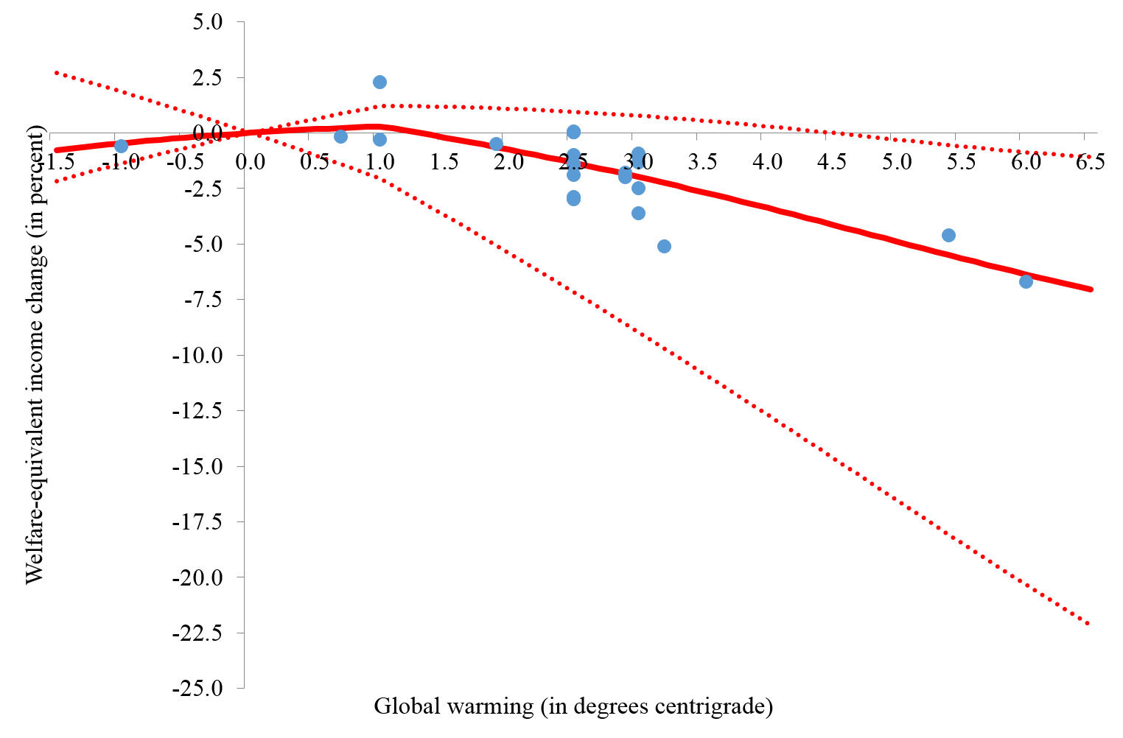

Slide 4
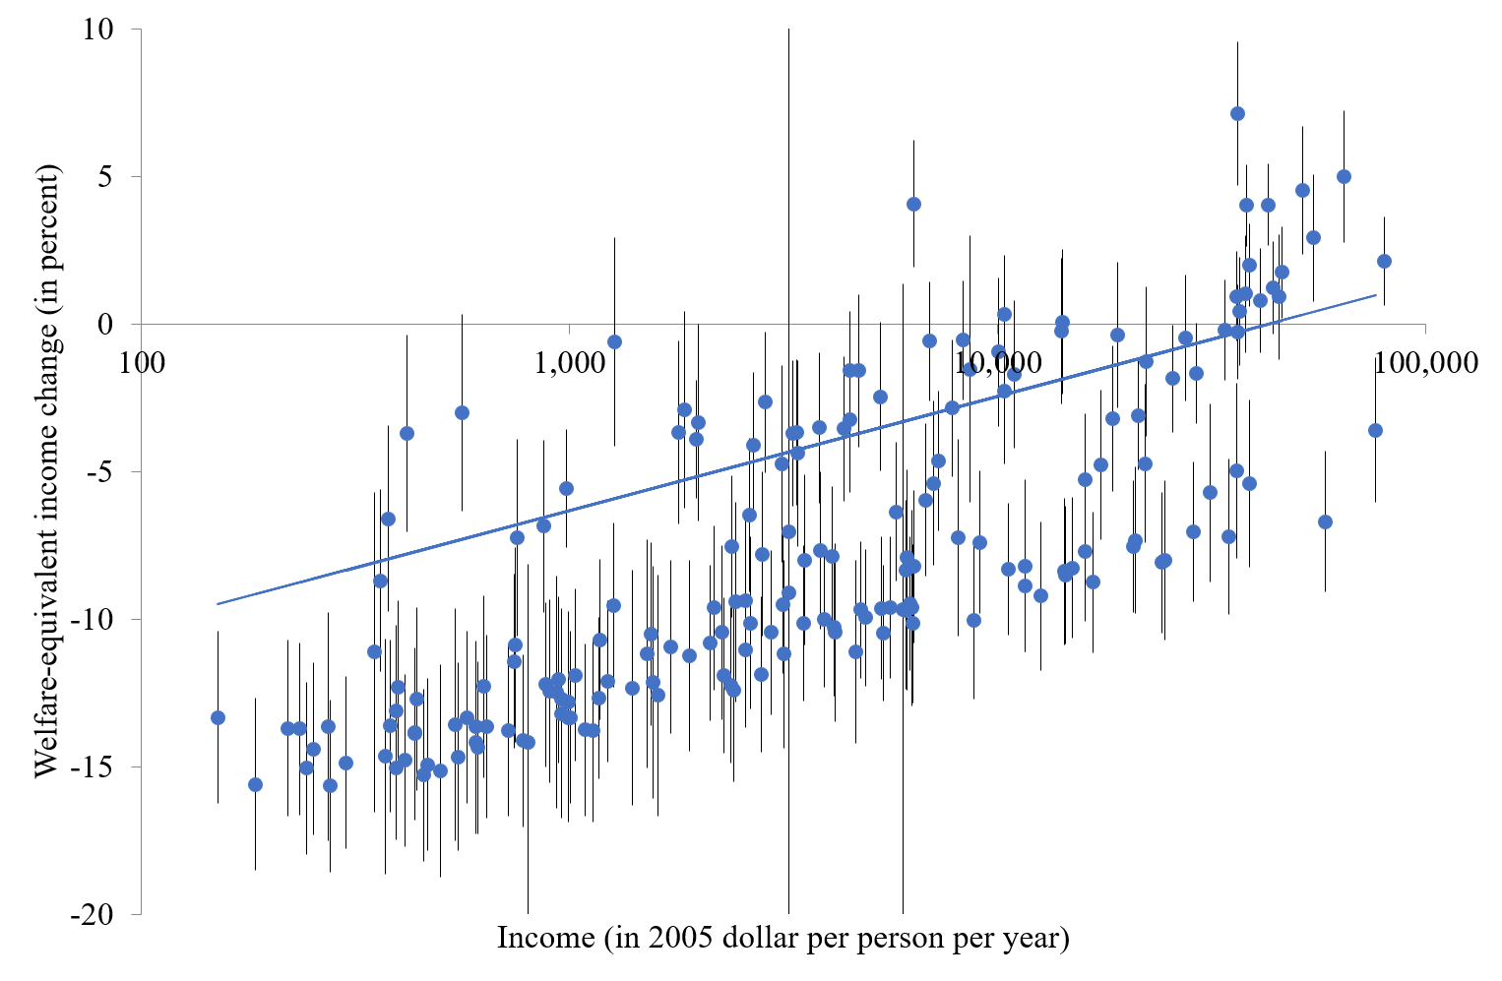
Exposure

Slide 5
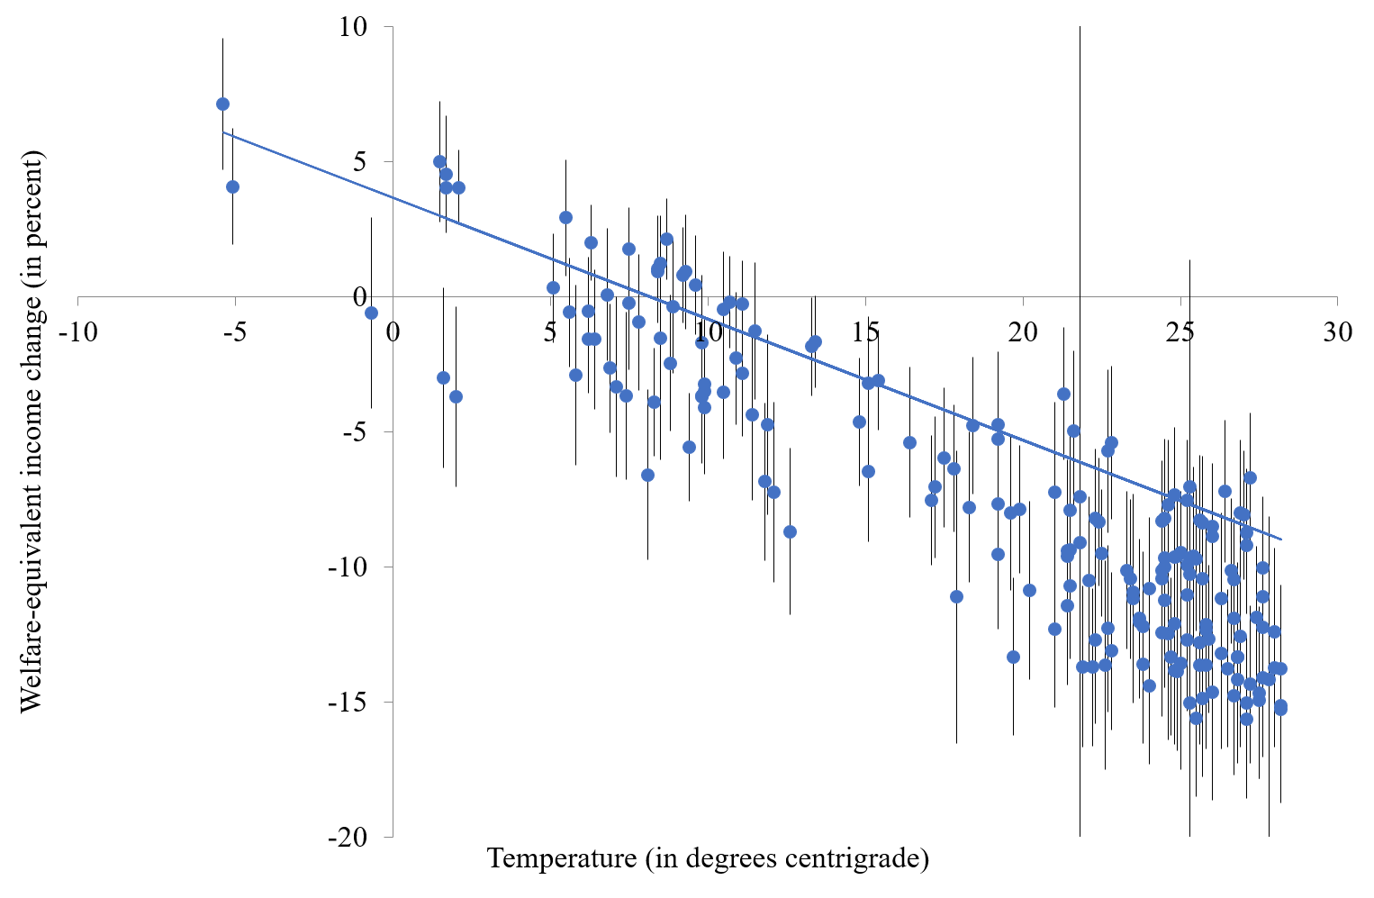
Exposure
Limits / analogues

Slide 6
Exposure
Limits / analogues
Adaptive capacity

Slide 7
Adaptive Capacity
Adaptive capacity is the ability to adapt
Adaptive capacity depends on
Available technological options
Available resources & their distribution
Human capital
Social capital
Risk sharing
Information management and attribution
Decision making
There is limited substitutability between these factors

Slide 9
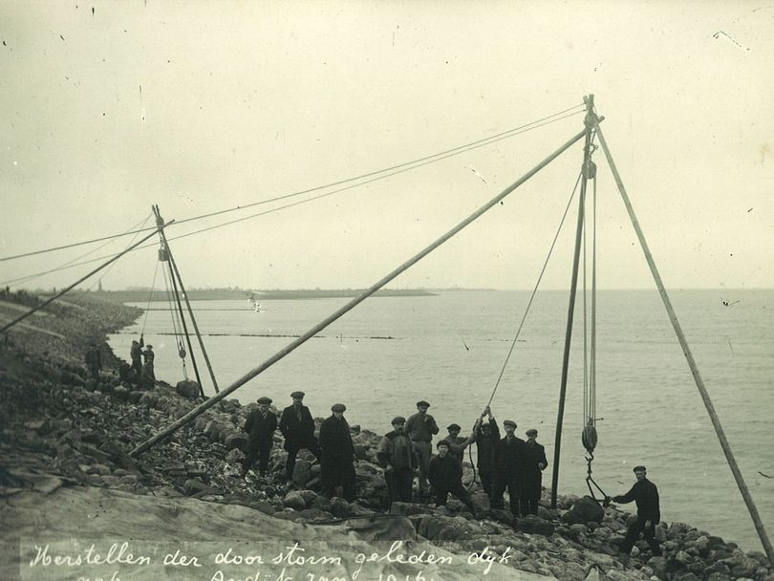
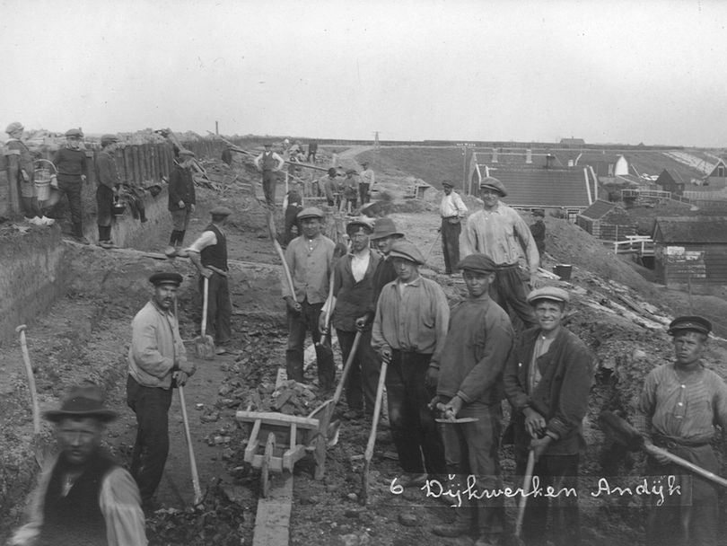
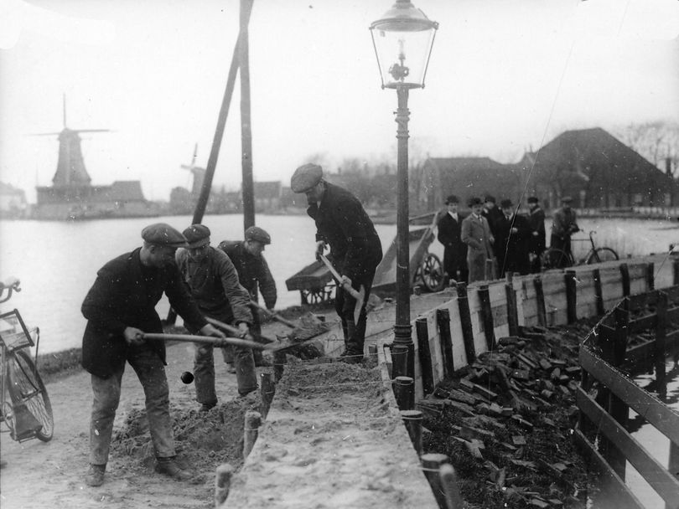
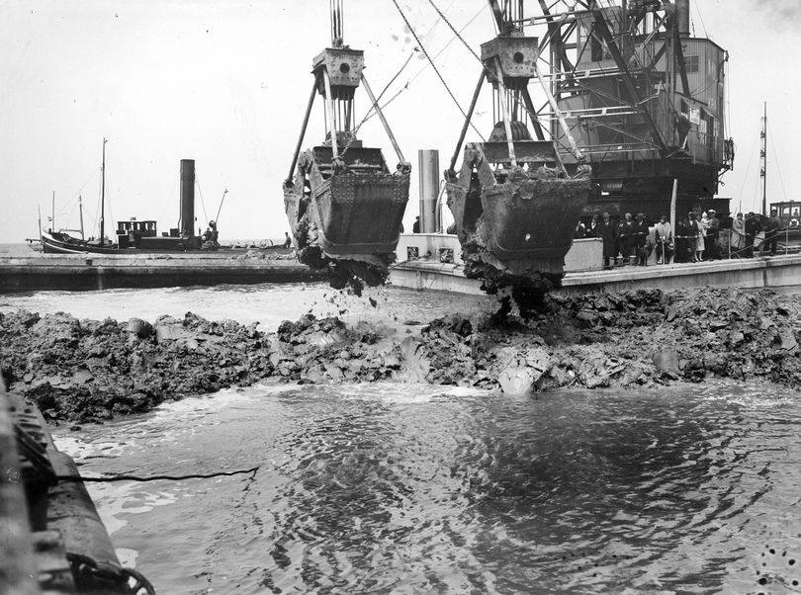
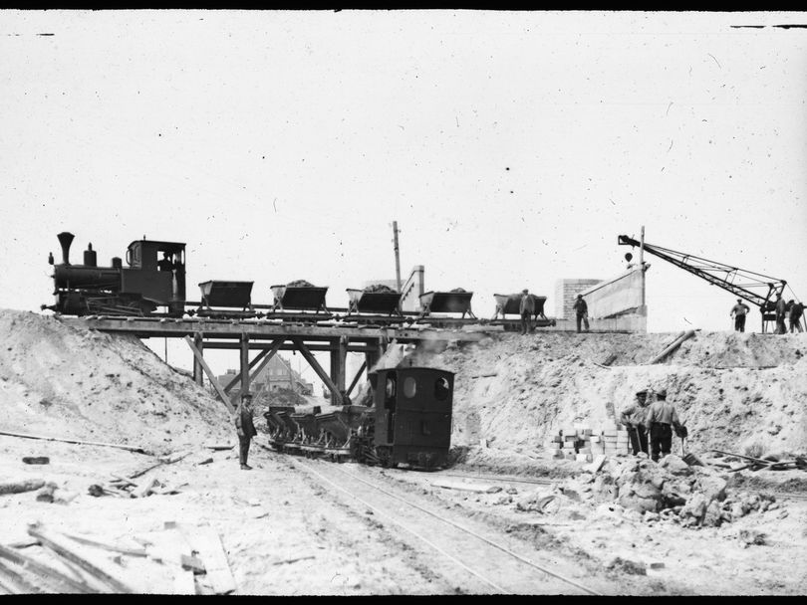
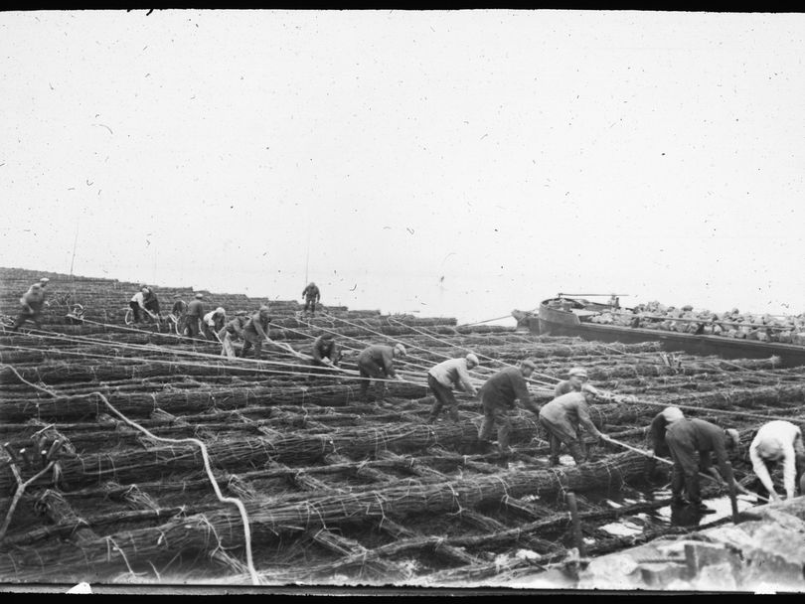
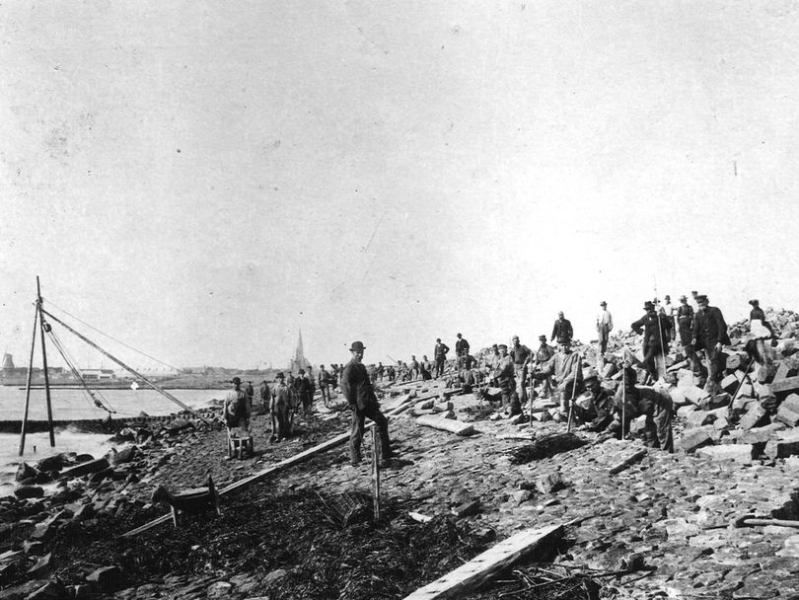

Slide 10
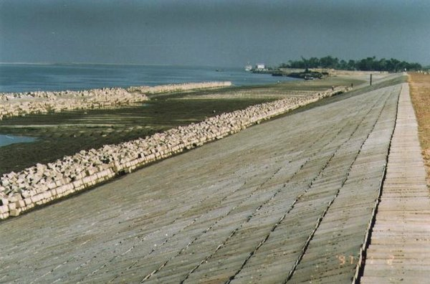
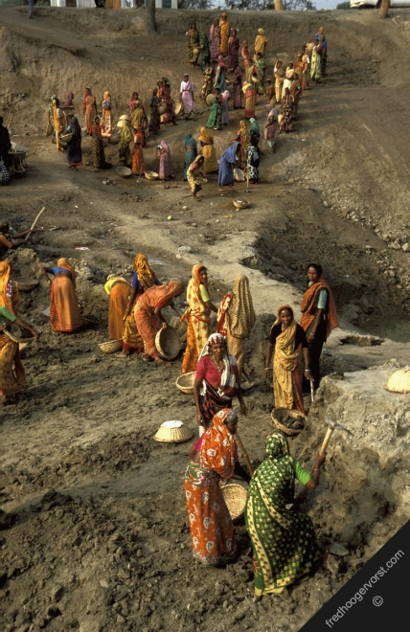
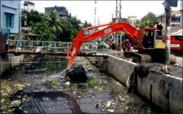
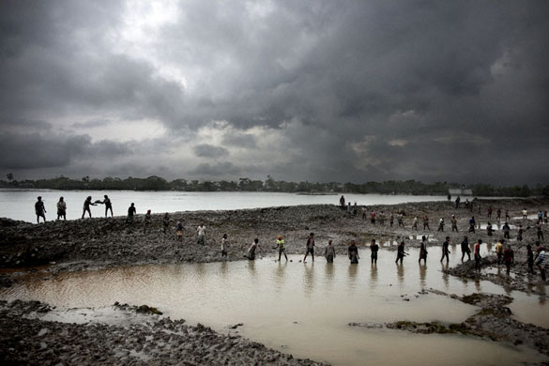
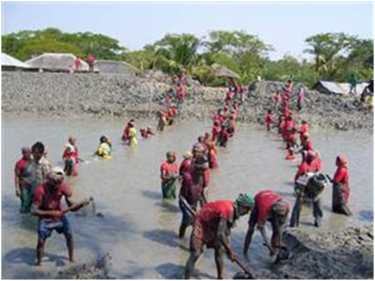

Slide 11
Bangladesh
Economically, Bangladesh is not far behind the Netherlands when it started its flood action plan
Technically, Bangladesh is far ahead
But
Corruption is terrible
Politics is antagonistic
Poor do not carry much weight in decision making
May think floods are a punishment by Allah rather than due to mismanagement by government

Slide 12
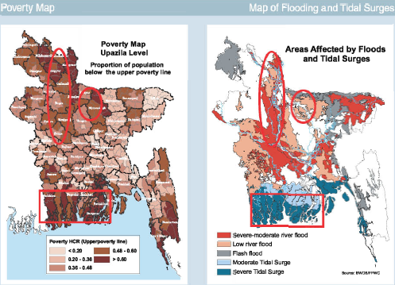

Slide 13
A brief history of the Netherlands
1848 European Spring
1849 Thorbecke Constitution
Central government
Broadly representative of population
1850 Modern dike building starts

Slide 14
Economic impacts
Why estimate the total economic impact of climate change?
Methods
Results and caveats
Weather v climate
Social cost of carbon
Distribution of impacts
Schelling conjecture
Impact on economic growth
Climate and development

Slide 15
Dynamics
Vulnerability to climate change is a function of exposure and adaptive capacity, both of which depend on development status
Future vulnerability will be very different from current vulnerability
Not only is future development uncertain, but also the link between development, exposure and adaptive capacity is unclear
I will illustrate this with the case of malaria

Slide 16
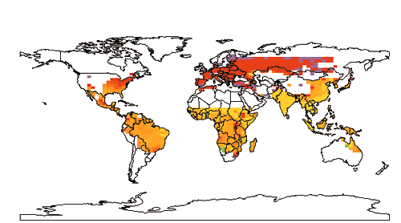


Slide 17
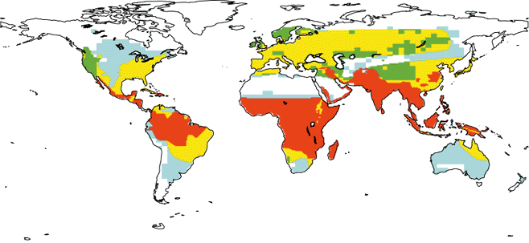


Slide 18
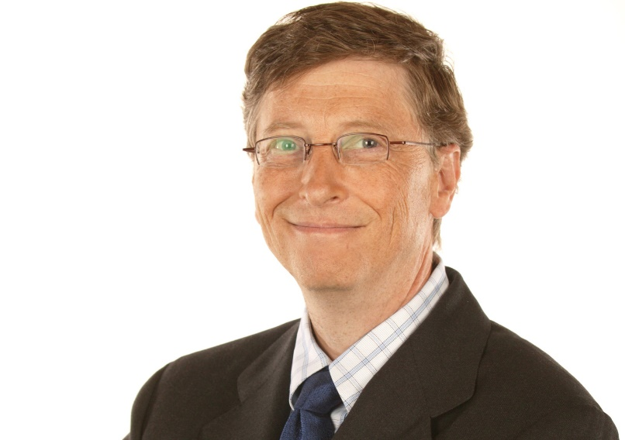

Slide 19
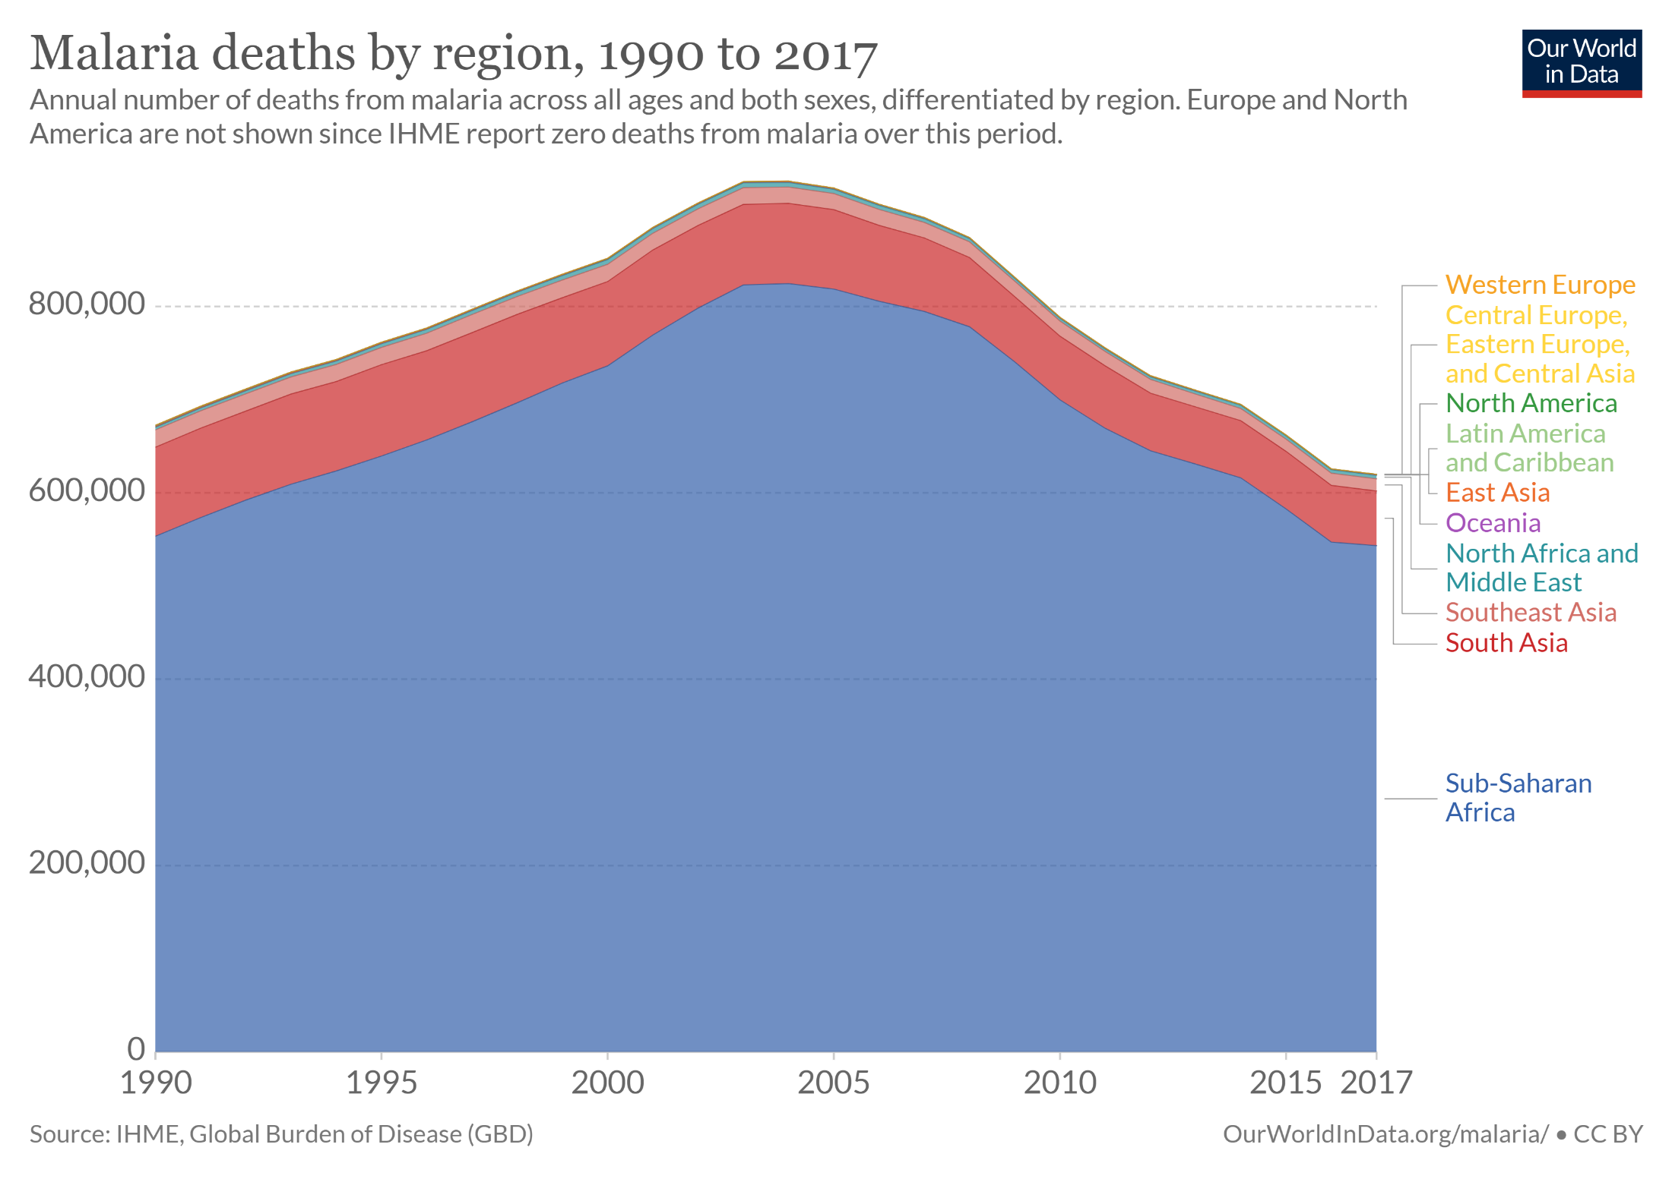
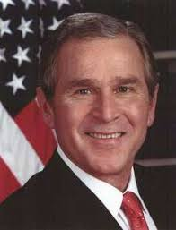

Slide 20
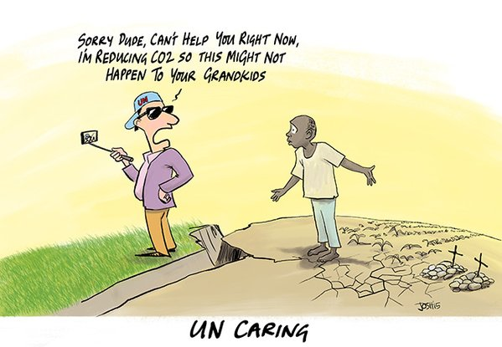
Schelling Conjecture

Slide 21
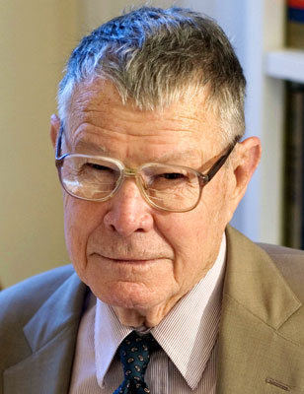
Schelling Conjecture
Nobel Laureate Tom Schelling asked
Why do we care about the grandchildren of people we do not seem to care about?
If we really do care about the impacts of climate change on the descendants of the current poor, are there better ways of helping them than through greenhouse gas emission reduction?
Is adaptation assistance a better way to reduce the impact of climate change?

Slide 22
Schelling Conjecture -2
Is adaptation assistance a better way to reduce the impact of climate change?
Yes, if you could be sure to invent say a malaria vaccine if you invested enough, and would be sure it would use appropriately
Adaptive capacity is complex, however, and closely related to development
Development assistance has proven difficult

Slide 23
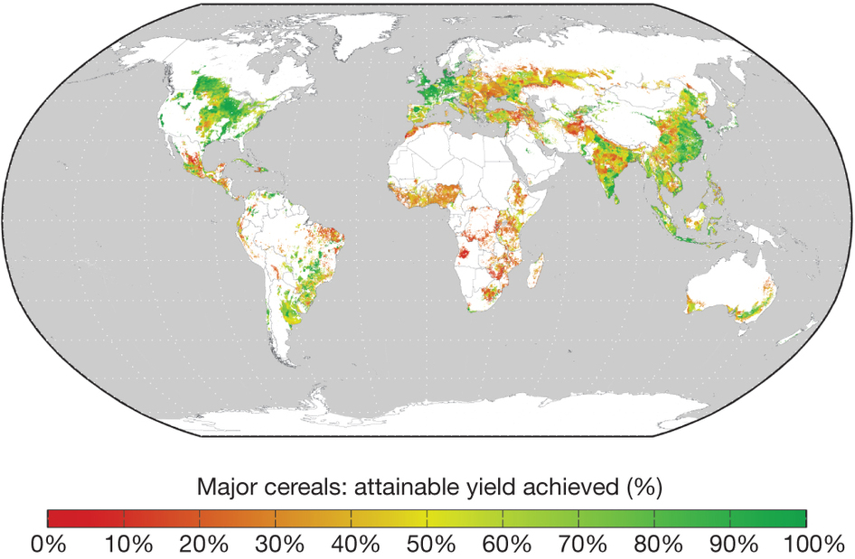

Slide 24
Schelling Conjecture -3
Besides, poverty implies vulnerability in general, but not always
Richer people
put higher values on health and environment
tend to live longer and thus develop cardiovascular diseases
might buy air conditioning that heats their environment

